Slide 1
South Copeland resident research, summer 2025
June – July 2025

Slide 2
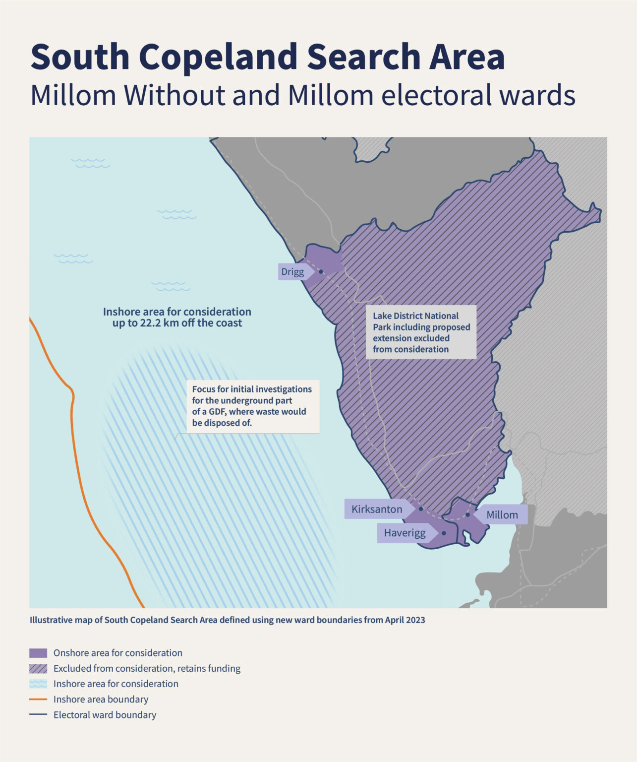
Methodology
  Survey methodology
Between 30 June and 21 July 2025, Yonder oversaw a survey of 201 residents (16+) interviewed in person across the wards of Millom and Millom Without. The interviews were conducted by Red Research, on behalf of Yonder.
Quotas were employed to ensure the resident sample was representative of the relative populations of the two wards. Weighting was then employed to ensure the sample was representative in terms of the age and sex profile of the population in question.
With a sample of 201 and a 95% confidence interval, a margin of error of +/-7% is expected (though confidence intervals do vary depending on the values involved).
Where appropriate, results are compared with similar surveying conducted since 2022.
Yonder is a member of the British Polling Council and abides by its rules. For more information, see www.yonderconsulting.com.

Slide 3
Awareness & understanding

Slide 4
81% recalled seeing, reading, or hearing something in the past year, and 33% attributed their awareness to a leaflet or newsletter
Q. Before today, have you seen or read or heard anything about nuclear waste or geological disposal or a Geological Disposal Facility (GDF) anywhere over the past year? If so, where?
Base: Jul 2022 (158); Jun 2023 (187); Nov 2023 (203); Mar 2024 (201); Oct 2024 (200); March 2025 (200); July 2025 (201)
Source: South Copeland resident research summer 2025

Slide 5
Over half correctly identified the current storage approach for the most hazardous waste, whereas 1-in-4 were unsure
Q. And what best describes your understanding of how the UK currently manages, stores or disposes of its most hazardous radioactive waste** – the most radioactive of waste?
Base: Jul 2022 (158); Jun 2023 (187); Nov 2023 (203); Mar 2024 (201); Oct 2024 (200); March 2025 (200); July 2025 (201)
Source: South Copeland resident research summer 2025
**Prior to October 2024, this was referred to as higher activity radioactive waste’

Slide 6
80% correctly identified the accurate description of a GDF
Q. Which, if any, of the following statements best describes what you know (if anything) about Geological Disposal Facilities?
Base: Jul 2022 (158); Jun 2023 (187); Nov 2023 (203); Mar 2024 (201); Oct 2024 (200); March 2025 (200); July 2025 (201)
Source: South Copeland resident research summer 2025

Slide 7
Awareness of the Community Partnership and the South Copeland Search Area remained high
Q. Before today, were you aware or unaware of the following?
[% of residents saying they were aware]
Base: Jul 2022 (158); Jun 2023 (187); Nov 2023 (203); Mar 2024 (201); Oct 2024 (200); March 2025 (200); July 2025 (201)
Source: South Copeland resident research summer 2025

Slide 8
Since March, the proportion of residents claiming awareness of the Areas of Focus increased
Q. Before today, were you aware or unaware of the following?
“NWS has identified areas within the South Copeland Search Area, which are called 'Areas of Focus' [...] The Surface Area of Focus is between the villages of Haverigg and Kirksanton while the Sub Surface Area of Focus is off the coast under the seabed in the inshore area up to 22km beyond the coast.”
March 2025
July 2025
Base: total respondents March 2025 (200); total respondents July 2025 (201)
Source: South Copeland resident research summer 2025

Slide 9
Geological disposal

Slide 10
31% supported the construction of a GDF in the Search Area and 35% opposed it
Q. Please imagine that the government proposed to construct Geological Disposal Facility (GDF) within the South Copeland Search Area – which covers parts of the wards of Millom and Millom Without as well as areas underneath the seabed off the coast of Copeland.
-34
+11
+35
+5
+21
+4
-4
NET support:
Base: Jul 2022 (158); Jun 2023 (187); Nov 2023 (203); Mar 2024 (201); Oct 2024 (200); March 2025 (200); July 2025 (201)
Source: South Copeland resident research summer 2025

Slide 11
Information needs & engagement

Slide 12
Information requests were diverse, with geology the most commonly requested in July
Q. What kind of information would you like to receive regarding geological disposal and the siting process?* (Only showing top ten information needs)
Base: total respondents July 2025 (201)
Source: South Copeland resident research summer 2025

Slide 13
When prompted, residents indicated a preference for a variety of engagement methods
Q. How, if at all, would you like to join in a conversation and give your views regarding geological disposal and the siting process?
All options
NET
Base: total respondents July 2025 (201)
Source: South Copeland resident research summer 2025

Slide 14
Northburgh House
10 Northburgh Street
London EC1V 0AT
+44 (0)20 7253 9900
hello@yonderconsulting.com
www.yonderconsulting.com

