Slide 1
South Copeland resident research, spring 2025
March 2025

Slide 2
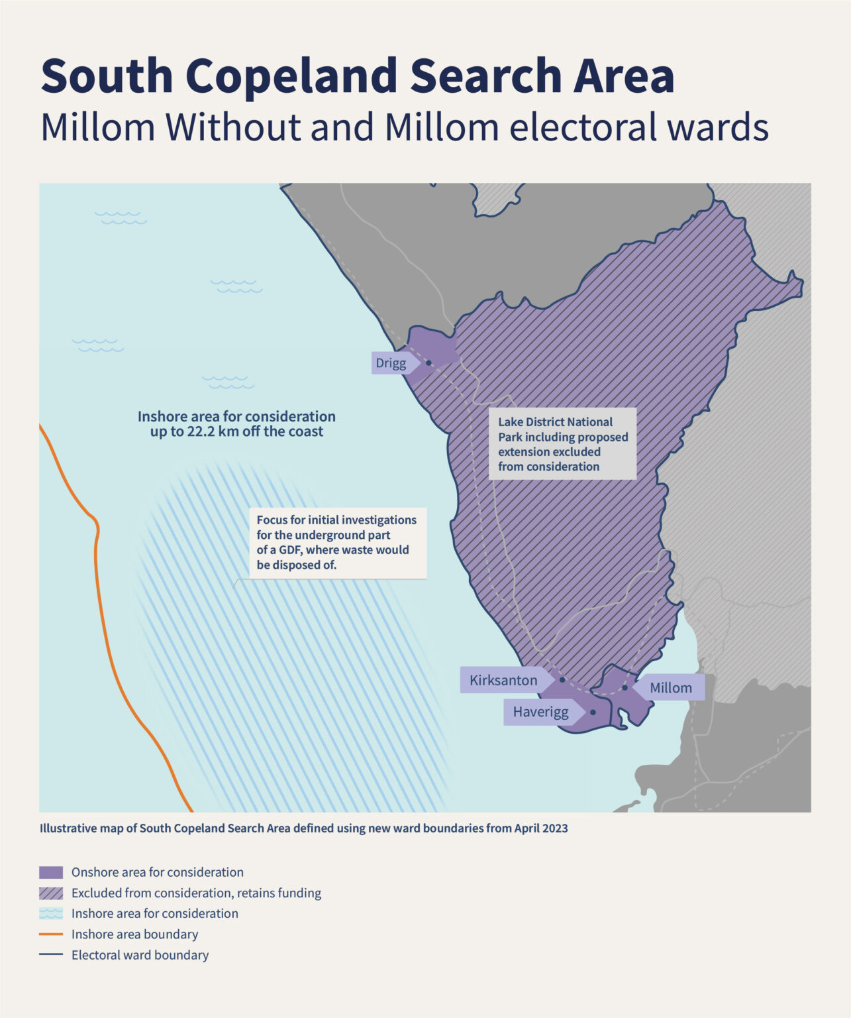
Methodology
  Survey methodology
Between 11 and 19 March 2025, Yonder oversaw a survey of 200 residents (16+) interviewed in person across the wards of Millom and Millom Without. The interviews were conducted by Red Research, on behalf of Yonder.
Quotas were employed to ensure the resident sample was representative of the relative populations of the two wards. Weighting was then employed to ensure the sample was representative in terms of the age and sex profile of the population in question.
With a sample of 200 and a 95% confidence interval, a margin of error of +/-7% is expected (though confidence intervals do vary depending on the values involved).
Where appropriate, results are compared with similar surveying conducted since 2022.
Yonder is a member of the British Polling Council and abides by its rules. For more information, see www.yonderconsulting.com.

Slide 3
Awareness & understanding

Slide 4
Three-quarters recalled seeing, reading, or hearing something in the past year, and 41% attributed their awareness to a leaflet or newsletter
Q. Before today, have you seen or read or heard anything about nuclear waste or geological disposal or a Geological Disposal Facility (GDF) anywhere over the past year? If so, where?
Base: total respondents Jul 2022 (158); total respondents Jun 2023 (187); total respondents Nov 2023 (203); total respondents Mar 2024 (201); total respondents Oct 2024 (200); total respondents March 2025 (200)
Source: South Copeland resident research spring 2025

Slide 5
2-in-5 correctly identified the current storage approach for the most hazardous waste, but the same proportion were unsure
Q. And what best describes your understanding of how the UK currently manages, stores or disposes of its most hazardous radioactive waste – the most radioactive of waste?
Base: total respondents Jul 2022 (158); total respondents Jun 2023 (187); total respondents Nov 2023 (203); total respondents Mar 2024 (201); total respondents Oct 2024 (200); total respondents March 2025 (200)
Source: South Copeland resident research spring 2025
**Prior to October 2024, this was referred to as higher activity radioactive waste’

Slide 6
More than 2-in-3 correctly identified the accurate description of a GDF, with men more likely than women to identify the accurate description
Q. Which, if any, of the following statements best describes what you know (if anything) about Geological Disposal Facilities?
Base: total respondents Jul 2022 (158); total respondents Jun 2023 (187); total respondents Nov 2023 (203); total respondents Mar 2024 (201); total respondents Oct 2024 (200); total respondents March 2025 (200)
Source: South Copeland resident research spring 2025

Slide 7
Awareness of the Community Partnership and the South Copeland Search Area remained high
Q. Before today, were you aware or unaware of the following?
[% of residents saying they were aware]
Base: total respondents Jul 2022 (158); total respondents Jun 2023 (187); total respondents Nov 2023 (203); total respondents Mar 2024 (201); total respondents Oct 2024 (200); total respondents March 2025 (200)
Source: South Copeland resident research spring 2025

Slide 8
Nearly two-fifths claimed awareness of the Areas of Focus announcement
Q. Before today, were you aware or unaware of the following?
“NWS has identified areas within the South Copeland Search Area, which are called 'Areas of Focus' [...] The Surface Area of Focus is between the villages of Haverigg and Kirksanton while the Sub Surface Area of Focus is off the coast under the seabed in the inshore area up to 22km beyond the coast.”
Don’t know
Aware
Unaware
Base: total respondents March 2025 (200)
Source: South Copeland resident research spring 2025

Slide 9
Geological disposal

Slide 10
34% supported the construction of a GDF within the Search Area, whilst 30% opposed it
Q. Please imagine that the government proposed to construct Geological Disposal Facility (GDF) within the South Copeland Search Area – which covers parts of the wards of Millom and Millom Without as well as areas underneath the seabed off the coast of Copeland.
-34
+11
+35
+5
+21
+4
NET support:
Base: total respondents Jul 2022 (158); total respondents Jun 2023 (187); total respondents Nov 2023 (203); total respondents Mar 2024 (201); total respondents Oct 2024 (200); total respondents March 2025 (200)
Source: South Copeland resident research spring 2025

Slide 11
Information needs & engagement

Slide 12
Postal information was the favoured method for communication about geological disposal and the siting process, followed by online sources
Q. How would you like to receive information about geological disposal and the siting process?*
*Note: question was open-ended. Respondents’ spontaneous answers have been grouped into consistent themes for the purpose of analysis
Base: total respondents March 2025 (200)
Source: South Copeland resident research spring 2025

Slide 13
When prompted, the majority claimed that they did not want to engage in a conversation about the subject matter
Q. How, if at all, would you like to join in a conversation and give your views regarding geological disposal and the siting process?*
All options
NET
*Note: question was open-ended. Respondents’ spontaneous answers have been grouped into consistent themes for the purpose of analysis
Base: total respondents March 2025 (200)
Source: South Copeland resident research spring 2025

Slide 14
Northburgh House
10 Northburgh Street
London EC1V 0AT
+44 (0)20 7253 9900
hello@yonderconsulting.com
www.yonderconsulting.com

